Slide 1

(Management Topic in Environmental Studies)
B. Tech 7TH Semester
Global Warming and Climate change
Department: Chemistry
Subject: MTES (CHM 2049)

Slide 2

Contents
Introduction of Global Warming and Climate Change
Causes of Climate Change
Working Principle of Green House Gases
Types, Sources, Level and Production of Green House Gases
Depletion of Stratospheric Ozone and Climate Change
Impact of Global Warming
Global Climate Change Model and Earth energy Budgets
Mitigation of Global Warming
Notes:
2

Slide 3
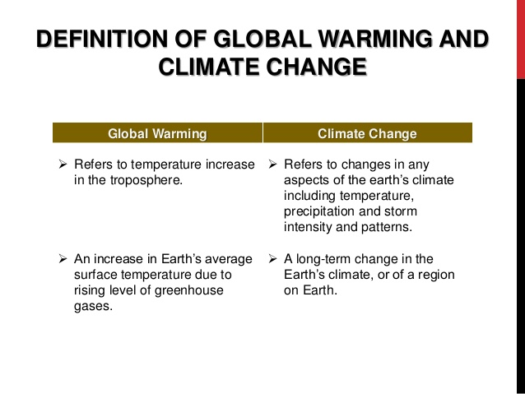
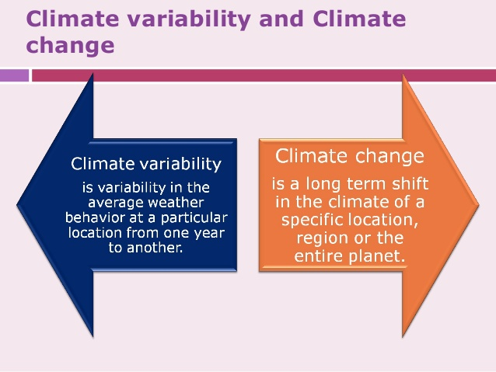

Slide 4
Causes of Climate Change
Feedback Mechanisms
Anthropogenic Global Warming
Bio-thermostat
Variations in Solar Radiation
Solar Irradiance
Sunspot Activity
Earth-Sun Geometry (Milankovitch cycles)
Atmospheric Dust and Volcanoes
Distribution of Continents
Plate Tectonics
Mountain Building
Ocean Variation
Thermohaline Circulation

Slide 5
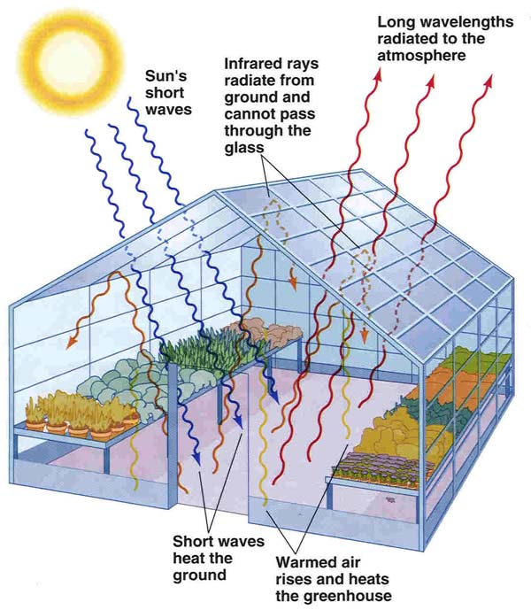
Anthropogenic Global Warming
Principle of Green House Gases ?

Slide 6
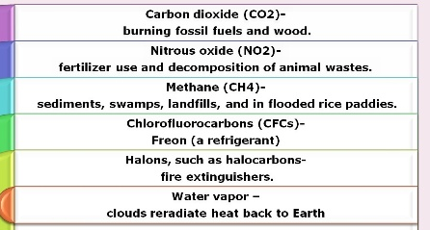
Type and sources Greenhouse Gases
        H₂O = 1-3%
        CO₂ = .035%
        CH₄
        N₂O
        O₃
        CFC’s
High
Conc.
Sources of ozone
Naturally occurring
Anthropogenic
Trace
Hydrofluorocarbons (HFCs), perfluorocarbons (PFCs) and sulphur hexafluoride (SF₆).
Sources of Green house gases

Slide 7
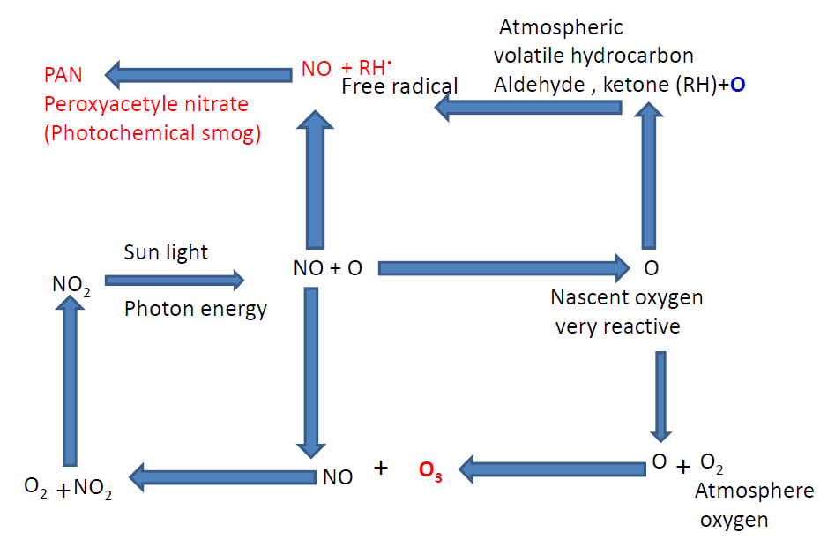
Photochemical Smog and formation of ground level Ozone

Slide 8
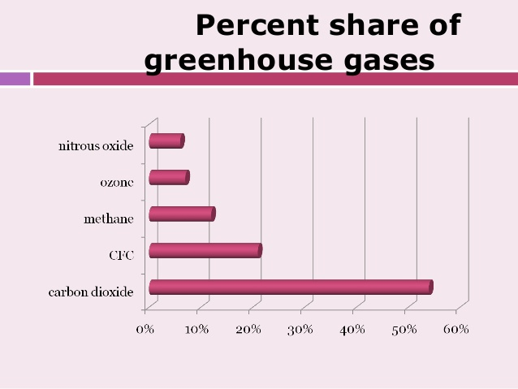

Slide 9
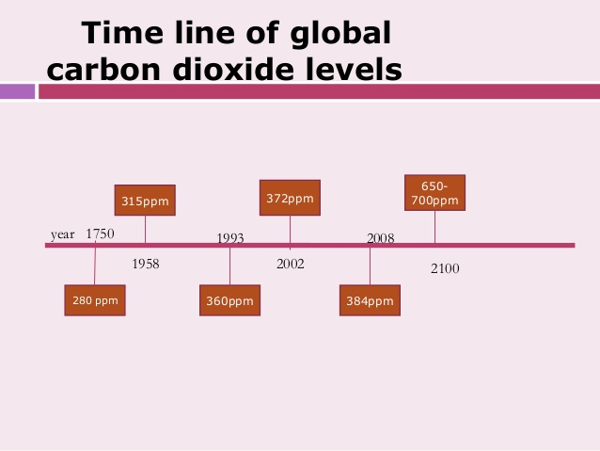

Slide 10
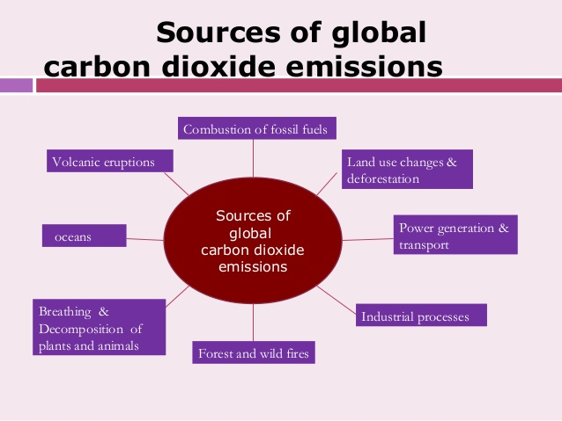

Slide 11
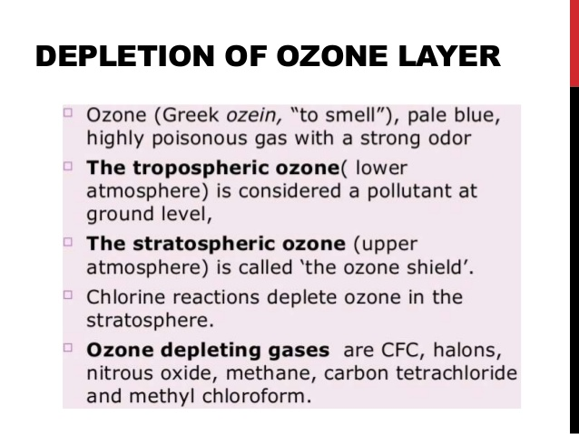
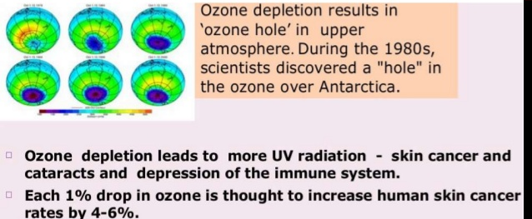
Depletion of Stratospheric Ozone and Climate change

Slide 12
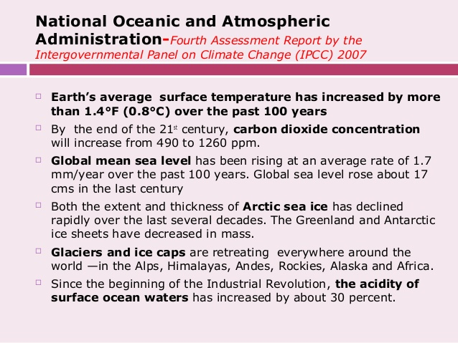
Impact of Global Worming
Influence amount and pattern of precipitation, Drought

Slide 13
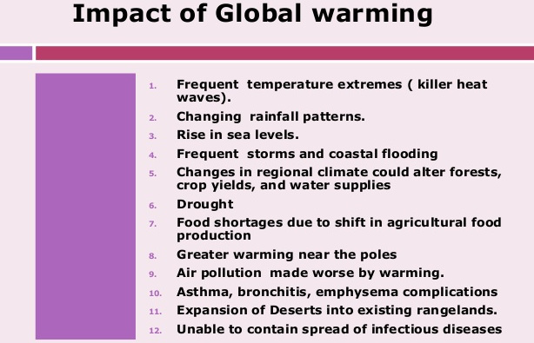

Slide 14
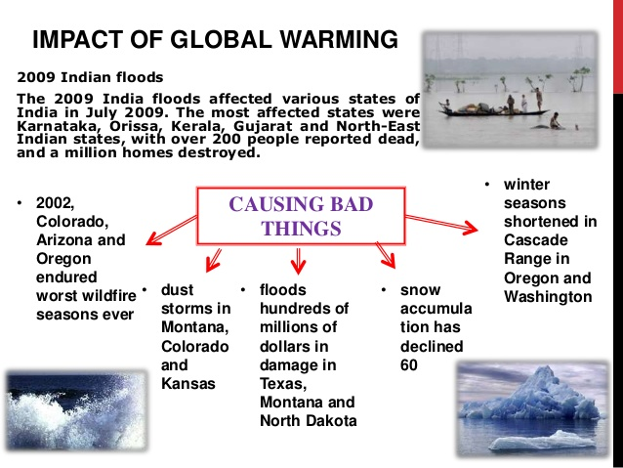
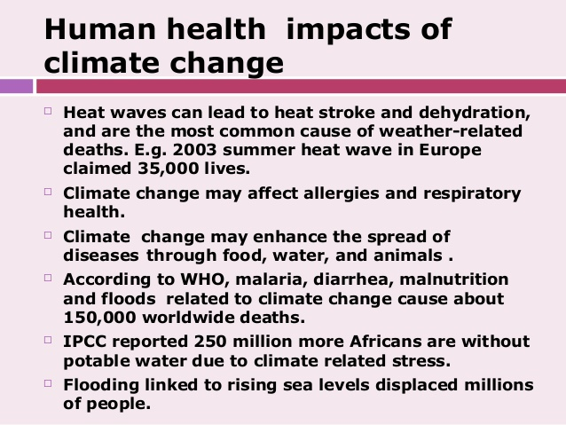

Slide 15
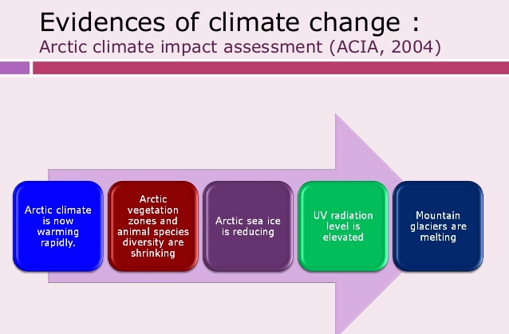

Slide 16
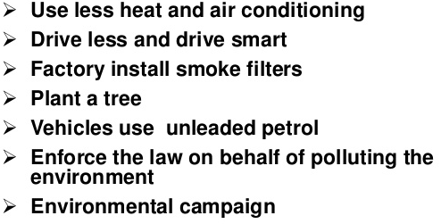
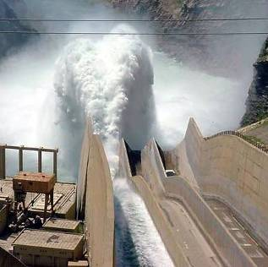
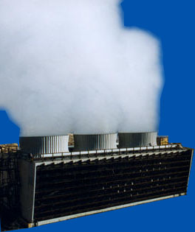
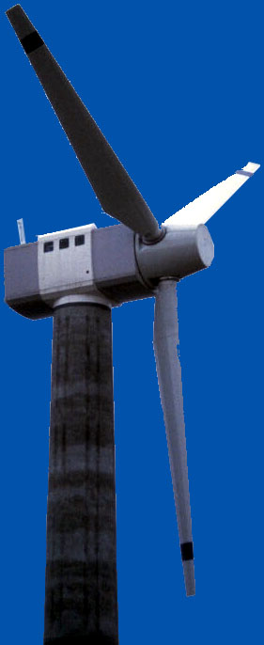
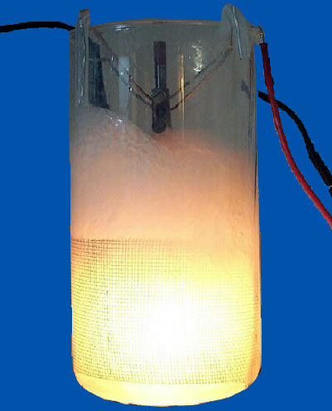
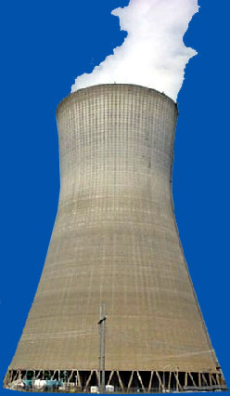


Mitigation of Global Warming
Conservation
  Reduce energy needs
  Recycling
Alternate energy sources
  Nuclear
  Wind
  Geothermal
  Hydroelectric
  Solar
  Fusion?
Notes:
Methods of mitigating global warming include 
Conservation 
Reduce energy needs, such as electrical usage, petroleum usage, reduced packaging 
Recycling, which uses less energy to produce products compared to 
Another way to reduce carbon emissions is to use alternate energy sources, such as 
Nuclear 
Wind 
Geothermal 
Hydroelectric 
Solar 
Fusion? 

Slide 17
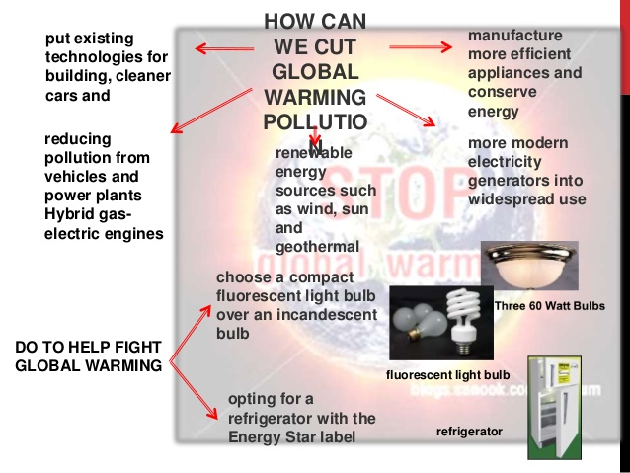

Slide 18
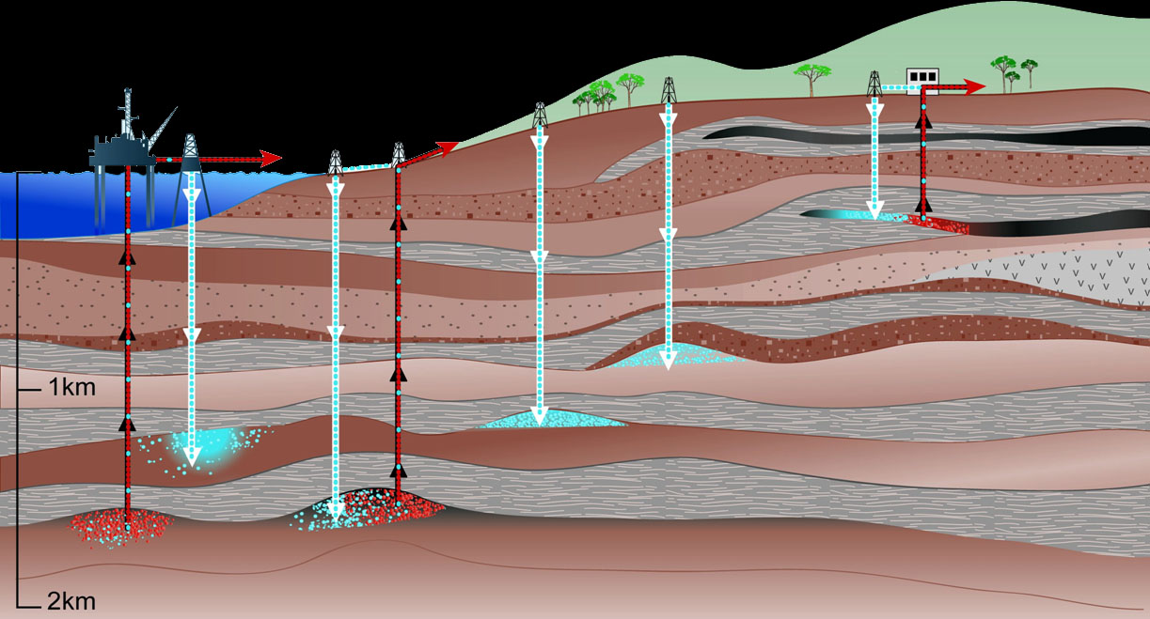
Storage of CO₂ in Geological Formations
Depleted oil and gas reservoirs
CO₂ in enhanced oil and gas recovery
CO₂ in enhanced coal bed methane recovery
1
4
3b
3a
2
Adapted from IPCC SRCCS Figure TS-7
Notes:
Another promising way to reduce global warming is to store carbon dioxide underground.  Carbon dioxide can be pumped into depleted oil and gas reservoirs.  In addition, carbon dioxide can be pumped into existing oil and gas deposits to enhance recovery. Another method  Carbon dioxide can also be used to enhance methane recovery from coal beds. 

Slide 19
